Slide 1
IMAGE CAPTIONING INFERENCE SERVICE
Cloud and ML : Project Presentation
Harsh Wani – hsw268
Sili Guo - sg6163

Slide 2
OUTLINE
Introduction and Problem Statement
Building Image-Captioning Application
Delivering performance enhancement and evaluation
Cloud vs Bare-Metal Comparison
GPU comparison with respect to concurrency
Deployment
Conclusion

Slide 3
INTRODUCTION AND PROBLEM STATEMENT
The objective of the project was to build an end-to-end deep learning application and deploy it on cloud as an inference service and to draw comparison on various aspects.
We provide comparative analysis of the model performance based on hyper-parameter tuning
Then we deploy the best model as an inference application on the cloud service using Docker and Kubernetes.
We provide exhaustive comparison on batch size and time between various GPUs with respect to concurrency
We then will compare the performance of it working on cloud with its performance working locally

Slide 4
IMAGE-CAPTIONING APPLICATION
The application we choose is a generator that can produce a short description of a picture given by user
This is an interesting application that combines the technique of image recognition and natural language processing.
The application uses a deep learning architecture that combines an Inception model and a LSTM to process images and the text respectively.
We use the Functional API in Keras which allows us to create Merge Models.
Dataset used –
- Flickr8k_Dataset: Contains 8092 photographs in JPEG format.
- Flickr8k_text: Contains a number of files containing different sources of descriptions for the photographs
6

Slide 5
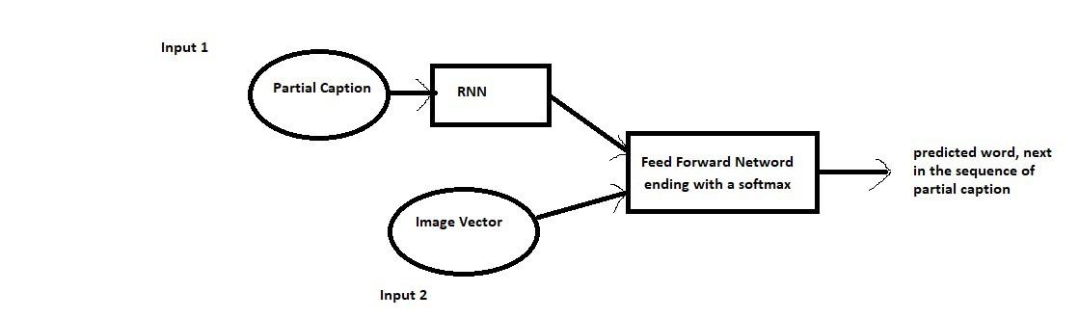
HIGH-LEVEL ARCHITECTURE
Photo Feature Extractor. This is a 71-layer xception model pre-trained on the ImageNet dataset. We have pre-processed the photos with the xception model (without the output layer) and will use the extracted features predicted by this model as input.
Sequence Processor. This is a word embedding layer for handling the text input, followed by a Long Short-Term Memory (LSTM) recurrent neural network layer.
Decoder (for lack of a better name). Both the feature extractor and sequence processor output a fixed-length vector. These are merged and processed by a Dense layer to make a final prediction.

Slide 6
ACHIEVING PERFORMANCE ENHANCEMENT - I
To improve the performance of the application, we implement various data pre-processing techniques and some hyperparameters tuning to see if that improves its performance.
We try to use grid search or random search to compare the performance of the training result.
Aim here is to figure out the best set of hyperparameters along with the most efficient method to process data in order to achieve the best performance

Slide 7
ACHIEVING PERFORMANCE ENHANCEMENT - II
We successfully improve the performance through -
- Hyperparameter tuning.
- We employ a learning rate scheduler policy. Choosing the learning rate is challenging and there is a trade-off between a small and a large value. So, the idea is to strike a continuous efficient balance during the training of the model.
- We created image feature vectors using pre-trained GloVe embeddings (Global Vectors for Word Representations).

Slide 8
PERFORMANCE EVALUATION - I
Pre-trained GloVe embeddings and scheduled LR policy
Epochs | Batch-size | BLEU-1 | BLEU-2 | BLEU-3 | BLEU-4 | Loss
25 | 32 | 0.609 | 0.418 | 0.322 | 0.195 | 2.41
25 | 64 | 0.608 | 0.412 | 0.312 | 0.185 | 2.55
25 | 128 | 0.640 | 0.447 | 0.342 | 0.208 | 2.89
Epochs | Batch-Size | BLEU-1 | BLEU-2 | BLEU-3 | BLEU-4 | Loss
50 | 32 | 0.608 | 0.408 | 0.304 | 0.175 | 2.09
75 | 32 | 0.597 | 0.405 | 0.302 | 0.173 | 1.91
Pre-trained GloVe embeddings and standard LR policy
Epochs Batch-size BLEU-1 BLEU-2 BLEU-3 BLEU-4 Loss
75 (0.01) | 32 | 0.50 | 0.294 | 0.205 | 0.094 | 4.14
75 (0.1) | 32 | 0.18 | 0.096 | 0.245 | 0.310 | 11.57

Slide 9
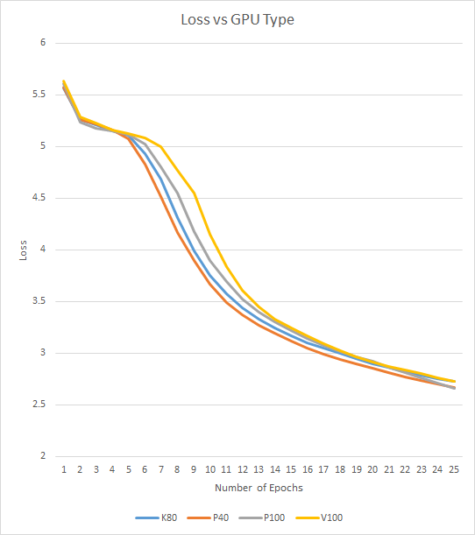
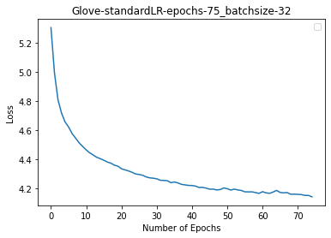
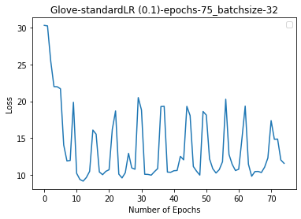
PERFORMANCE EVALUATION - II

Slide 10
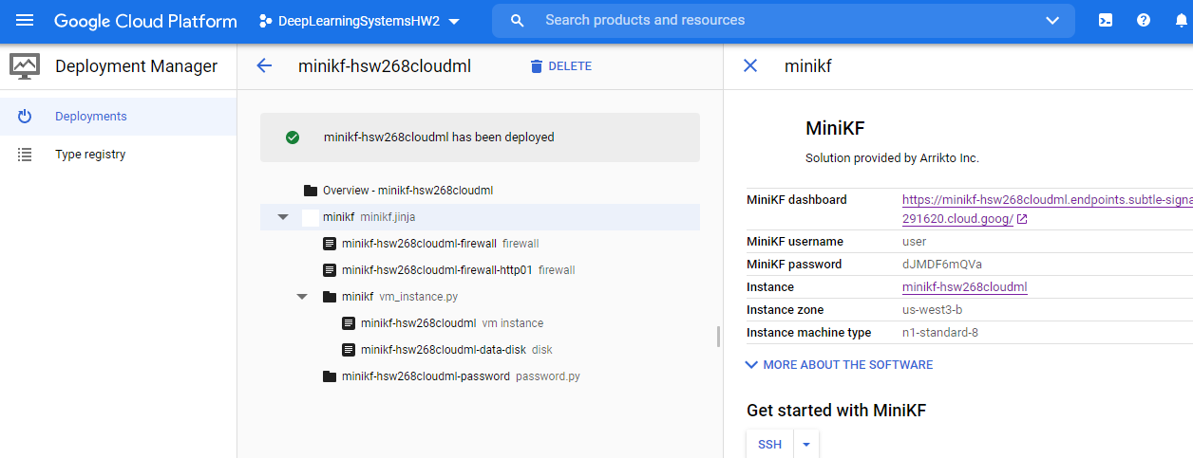
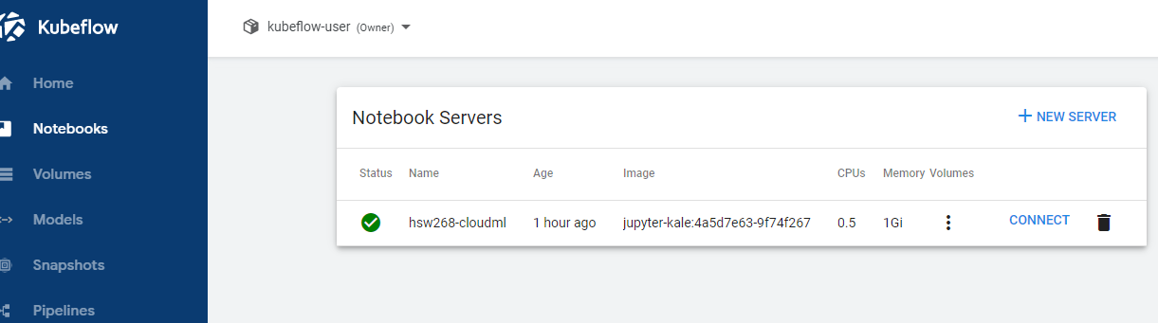
CLOUD VS BARE-METAL PERFORMANCE ANALYSIS - I

Slide 11
CLOUD VS BARE-METAL PERFORMANCE ANALYSIS - I
For GCP, we deploy a minicube instance for 25 epochs, batch size-32 with v8CPUs. As for bare-metal we used 2080Ti GPU.
 | Loss | Time (min)
GCP | 3.24 | 108
Bare Metal | 3.18 | 56

Slide 12
PERFORMANCE EVALUATION - III
Results without Pre-trained GloVe Embeddings
Epochs | Batch-size | BLEU-1 | BLEU-2 | BLEU-3 | BLEU-4 | Loss
25 | 32 | 0.123 | 0.011 | 0.067 | 0.105 | 3.198
25 | 64 | 0.103 | 0.005 | 0.043 | 0.073 | 3.410
25 | 128 | 0.101 | 0.012 | 0.003 | 0.009 | 3.564
Epochs | Batch-Size | BLEU-1 | BLEU-2 | BLEU-3 | BLEU-4 | Loss
50 | 32 | 0.107 | 0.014 | 0.004 | 0.0104 | 2.82
75 | 32 | 0.101 | 0.013 | 0.003 | 0.0101 | 2.69

Slide 13
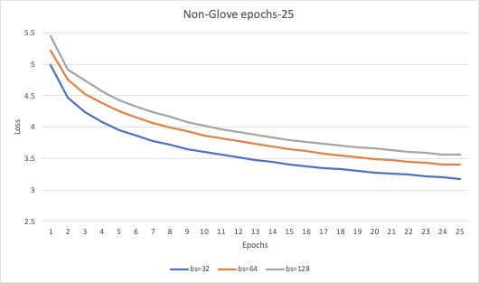
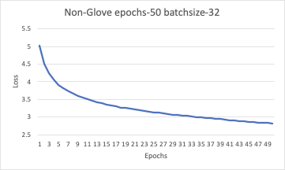
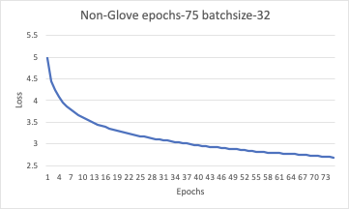
PERFORMANCE EVALUATION - IV

Slide 14
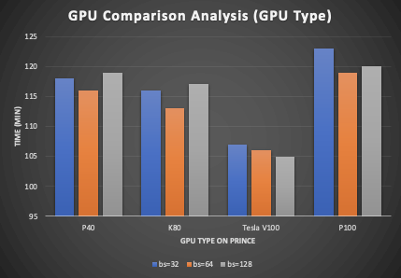
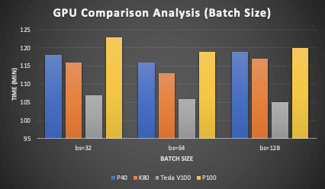
GPU (SINGLE CORE) VS BATCH-SIZE COMPARATIVE ANALYSIS
Tesla V100 shows best performance
P100 did worst in all conditions
Higher batch size not always give better performance

Slide 15
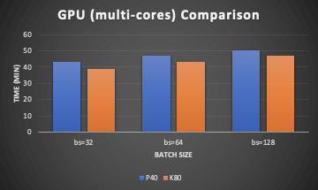
GPU (MULTIPLE CORES) VS BATCH-SIZE COMPARATIVE ANALYSIS
With multi-cores, the performance is largely improved
How batch size affect performance keep same as single core

Slide 16
DEPLOYING ON CLOUD
Flask related files
html template
Dockerfile
predict.py
Data folders
YAML file
Persistent Volume
Web services with port 5000/30000
Deployment with two replicas

Slide 17
Challenge
The code has keras and tensorflow out of date, we need to modify to make it work
Comparison made on different platform is hard to make the environment consistent
Unfamiliar with Flask and html, which takes time to let result show on browser

Slide 18
Conclusion
Achieved Goals
Build the model (based on existed works)
Improve performance of model
Tuning hyperparameter (Grid search)
Employed learning rate schedule policy
Different embedding layers (with/without Glove)
Deploy on Kubernetes using Flask and Docker

Slide 19
Conclusion
Comparison Result
By using Grid search, we are able to figure out the hyperparameters with best performance
The increasing of Batch size and Learning rate cause overfits
Multi-cores does not reduce time as much as we thought due to network delay
Using batch size scheduler and learning rate scheduler at same time not improve performance
Future work
Try to add an attention layer to further improve accuracy

Slide 20
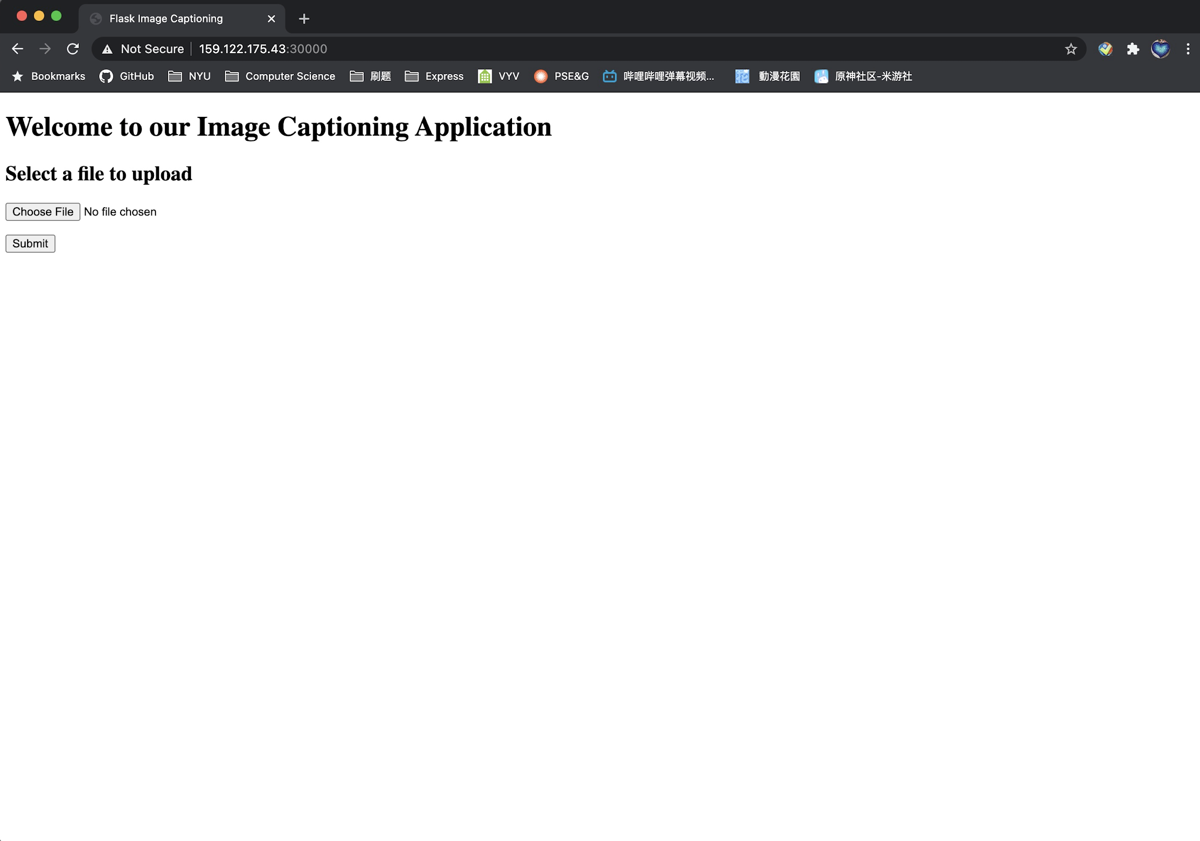
DEMO
http://159.122.175.43:30000

Slide 21
Thank You

